Slide 1
Bill Gates
By: Sahib Khangura

Slide 2
Microsoft’s Evolution
Founded on April 4, 1975 by Bill Gates and Paul Allen
In 1985 Microsoft releases Windows
Windows 95 included many innovations such as the Start menu
In 1998 the US Department of Justice charged Microsoft with violating antitrust laws by using its dominance to put competitors out of business
The Xbox
Microsoft Surface
Notes:
7 million copies sold of Windows 95
Internet Explorer linked with Windows

Slide 3
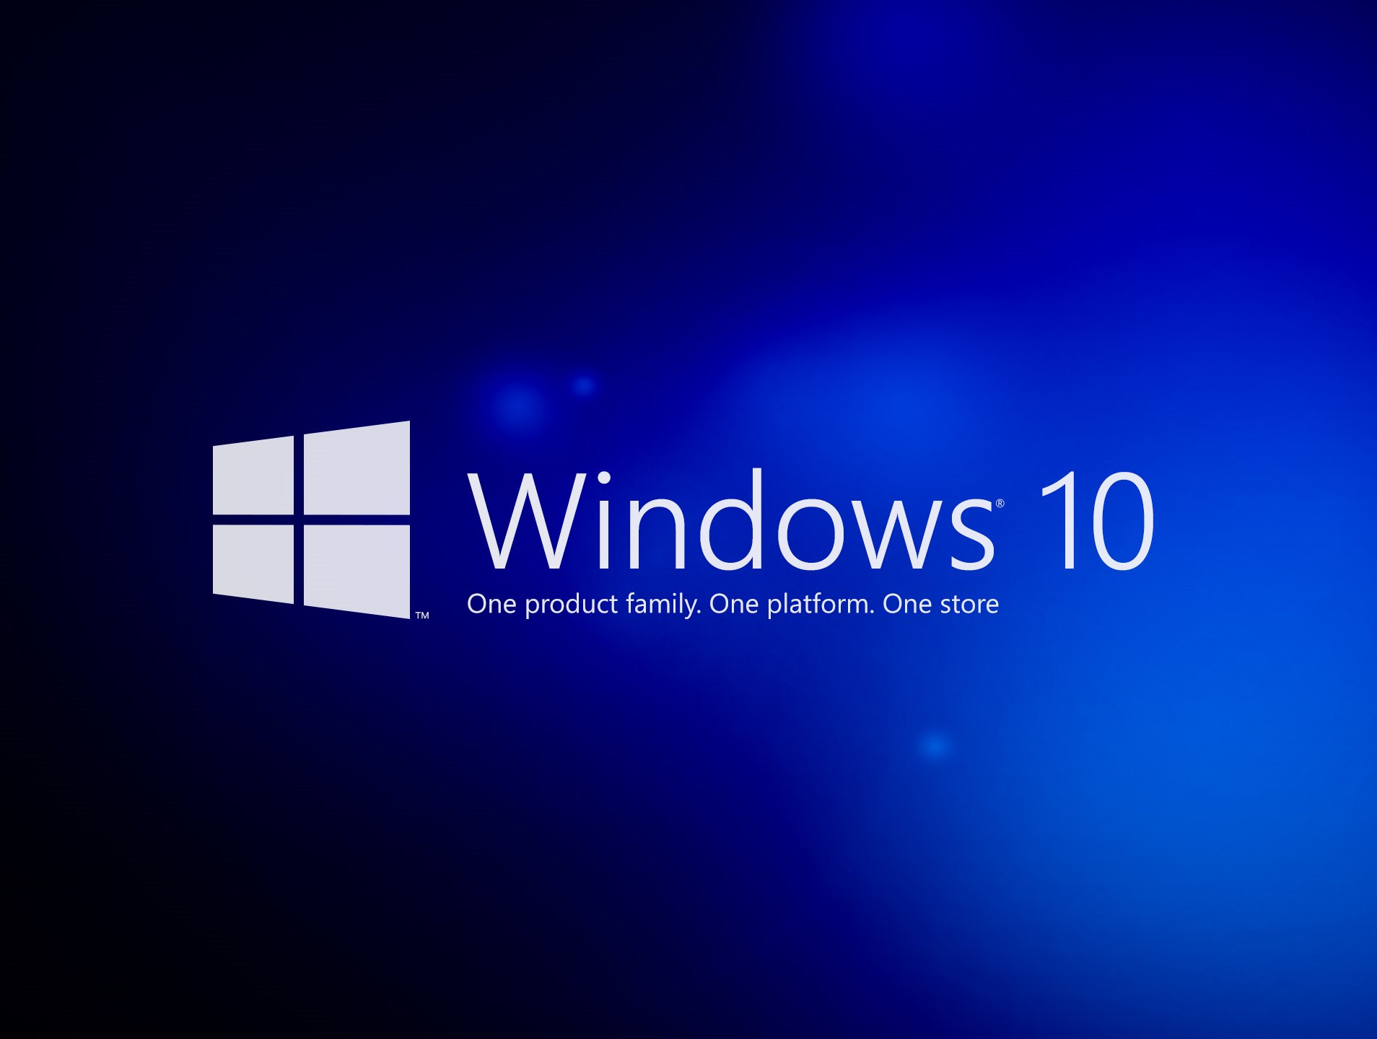
Competition
The main competitors are Apple, HP, Google, Oracle, IBM, Sony, Samsung and Nintendo
Many good store locations
Respected company
Excellent advertising and marketing
Installable on any PC or laptop
Notes:
Good reputation
Variety of items
Windows is installable on any PC or laptop
Every age group

Slide 4
The Free Market
Improve and develop their products
Windows is an easy-to-use program
They have excellent marketing and branding
Leader in innovation
Notes:
Improve and develop products
Improved the Windows system
Other products (Xbox and Skype)
Windows
Easy to use
Shortcuts for more experienced people
Marketing
Well know and respected company
Wide audience
Innovation
Improve Windows
Environmental minded

Slide 5
Future of Microsoft
By 2030 Microsoft wants to be carbon negative
By 2050 they want to remove all carbon emitted or through electricity since the company was founded
Reduced emissions by 6% in the first year
Want to help 25 million people get digital skills
20 million to help non-profit organizations
Notes:
Carbon Emissions
Launched in Jan 2020
11.6 million metric tons to 10.9 million metric tons
Carbon negative – emitting less carbon than taking out of the environment
Digital Skills
Cut emission in half by 2030

