Slide 1
Rocky Balboa as the Quintessential Humanistic Archetype for Motivation and Overcoming Universal Obstacles
Presented By:
Dr. Pete Cooper Ph.D., LPC-S

Slide 2
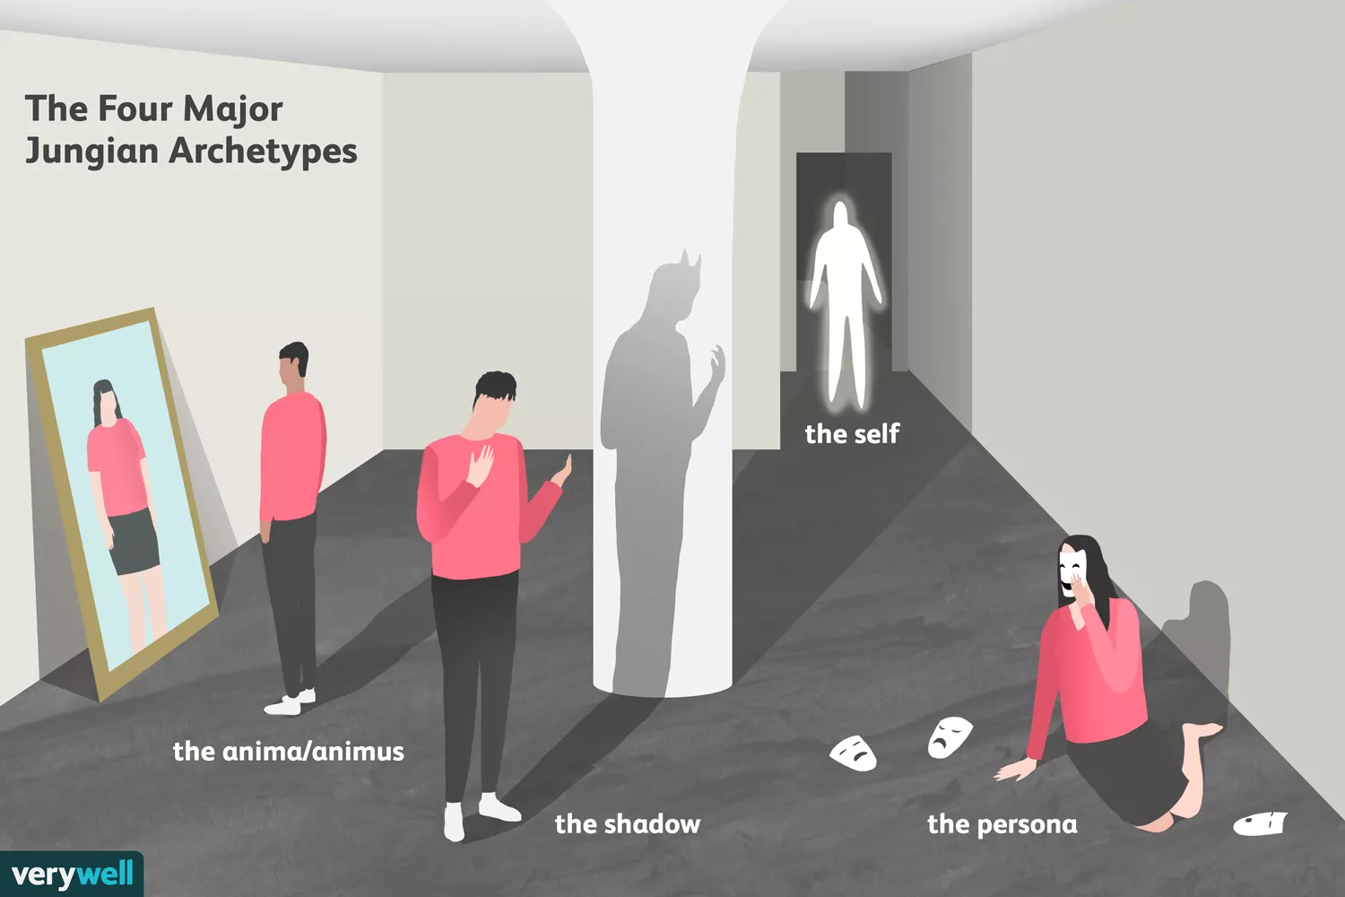

Slide 3
Other Archetypes
The father: Authority figure; stern; powerful.
The mother: Nurturing; comforting.
The child: Longing for innocence; rebirth; salvation.
The wise old man: Guidance; knowledge; wisdom.
The hero: Champion; defender; rescuer.
The maiden: Innocence; desire; purity.
The trickster: Deceiver; liar; trouble-maker.

Slide 4
The collective unconscious as described by Jung delves into symbols and images in which humanity is joined together (Wehr, 1971). Emotions are some of the most practical and realistic examples of the collective unconscious.
According to Jung, myth linked humanity to each other; for myth is what is believed by everyone, everywhere, for all time (Campbell & Moyers, 1988). Modern day myth/archetypes, in particular 20th century myth/archetypes were particularly evident in film.
The Joseph Campbell Foundation said of his encounters and time in Europe:
These encounters would eventually lead him to theorize that all myths are the
creative products of the human psyche, that artists are a culture's mythmakers,
and that mythologies are creative manifestations of humankind's universal need
to explain psychological, social, cosmological, and spiritual realities. ("About
Joseph Campbell," 2005)

Slide 5
One of the most important elements to recognize in the great characters/archetypes throughout history is that there is truth in fiction and that the creators of the characters pour elements of their own heart and soul into them, thereby bringing those characters to life. Additionally, the actors who portray these characters do the same with what they bring to the role.
Sylvester Stallone
Sylvester Stallone was born as a post WWII baby in the (appropriately named) Hell’s Kitchen section of Manhattan, NY. Some of his facial nerves were severed from misuse of forceps during his birth resulting in his droopy face and slurred speech. His family had moved around a great deal while he was a child and had behavioral problems in most of the schools he attended. Stallone attended over a dozen schools after being expelled for disciplinary problems in his childhood. He moved to Philadelphia, PA (hometown of Rocky) after his parents divorced and attended high school there.

Slide 6
After moving around a great deal yet again after attending college in Switzerland and Miami he
returned to his birthplace to pursue acting full-time. He was broke, barely getting by for years
sleeping in hostels, bus stations and selling his dog to keep from going hungry when he saw the 1975
fight between Chuck Wepner (a journeyman) and Muhammed Ali (the champion); the essence of life
imitating art. In the fight, Wepner withstood Ali’s barrage for 15 full rounds after losing the decision
to Ali. Nobody expected Wepner to be able to go the distance with Ali.

Slide 7
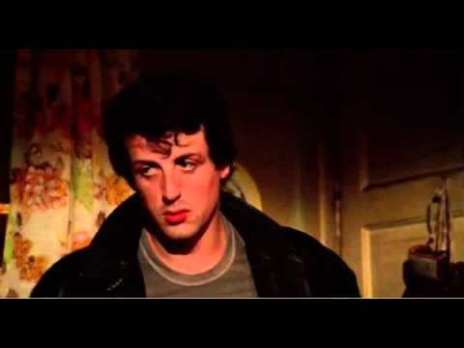
Rocky Balboa
Vogler (1998) noted that heroes need qualities that the audience can identify with that are propelled by universal drives, revenge, freedom, to be loved and understood, that can clearly be seen by the audience (p. 36).

Slide 8
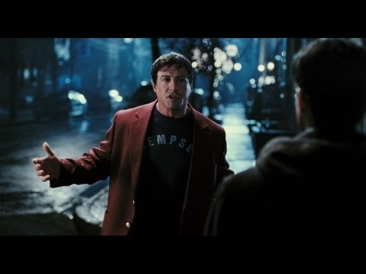

Slide 9
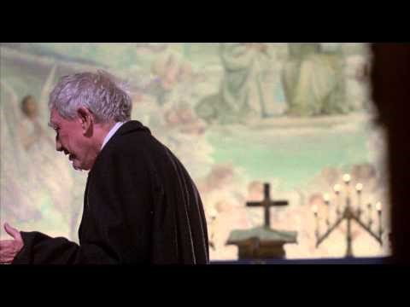
Mickey Goldmill

Slide 10
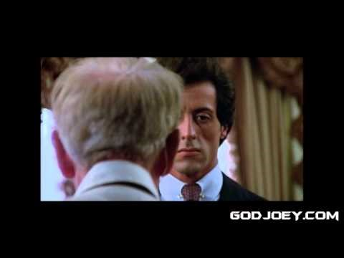

Slide 11
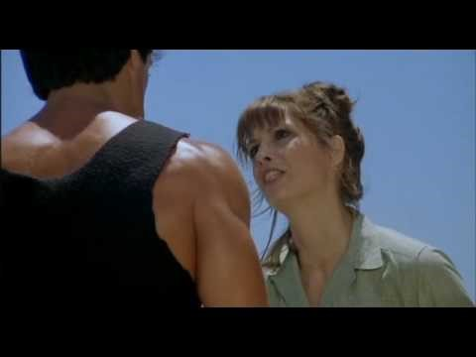
Adrian Balboa

Slide 12
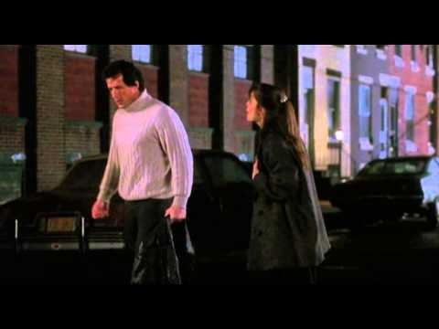

Slide 13
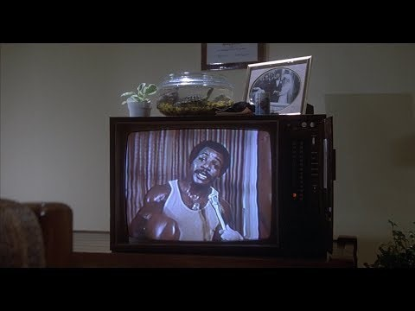
Apollo Creed

Slide 14
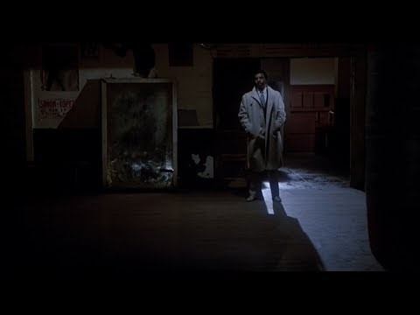

Slide 15
Clubber Lang

Slide 17
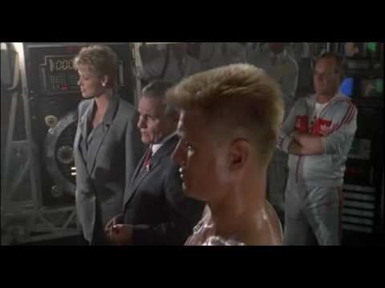
Ivan Drago

Slide 18
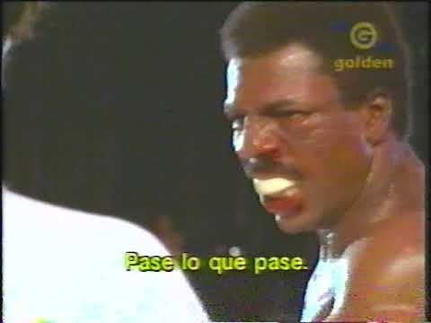

Slide 19
Tommy Gunn

Slide 21
ROCKY
Vogler (1998) noted that heroes need qualities that the audience can identify with that are propelled by universal drives, revenge, freedom, to be loved and understood, that can clearly be seen by the audience (p. 36). Although not everyone can relate to being a street brawler who fights in back alley clubs for menial money in the city of Philadelphia, nor relate to working for a loan shark, every human in the world can relate to the deeper underlying realities that Rocky faces. He is marginalized, has family problems, feels “less than” and given the short end of the stick because of what he was born into, taken advantage of, and feels that life has passed him by.
Conversely, despite these realities in which he finds himself, he is also a cockeyed optimist as he is a fighter (both literally, proverbially and metaphorically), and finds a way to cope and navigate through his situation by being compassionate, good hearted, humble and also serves as a mentor at various times in the film(s) (and is also mentored) to those in need or going down the wrong path. Additionally, as we will see in later aspects in the nemeses he will later face, is able to adapt and change with his surroundings to keep moving forward.

Slide 22
MICKY
The Micky character is the quintessential mentor in the first three films. He embodies many archetypes in one character such as the anima and animus through his nurturing and compassion as well as his leadership and hard-nosed approach to training. We see an arc in this character in that he eventually comes to not believe in Rocky any longer due to his own limitations and wanting to move on in his own life. He represents the wise old man, father figure, hero and mother archetypes as well.

Slide 23
ADRIAN
We see the Adrian character embodying the feminine archetype in her vulnerability and strength in terms of being aware of her own fears and overcoming them as well as being a strong nurturing presence in the relationship with Rocky. Without the presence of this strong anima in balance with the hero animus, he would not have the emotional resources or motivation to continue because he feels loved and supported as well as becoming emotionally centered when his loses his way.

Slide 24
APOLLO
We all face literal and proverbial adversaries in our lives in which we must deal with and face and overcome these challenges and obstacles. However, there are times when we either don’t have the belief in ourselves, the physical, psychological or spiritual tools, or the knowledge to be able to face our challenges and obstacles. In Apollo Creed, we see the arc of the character of Apollo Creed go from challenger/nemesis to Rocky (who also serves as hero in giving an unknown a chance for success) and mentor when assisting Rocky in facing Clubber Lang in the third film).

Slide 25
CLUBBER
The Clubber Lang character embodies Rocky’s Shadow archetype in the third film in that he represents Rocky’s previous hunger as a young fighter, which Rocky has lost since becoming champion, as well as being a mirror image of Rocky’s brawling fighting style and also being another southpaw. Additionally, we see Clubber as being simply too big and too strong for Rocky to try and outpunch, leading to Rocky’s (with Apollo’s assistance) complete change in style to later defeat Clubber.

Slide 26
DRAGO
In the fourth installment of the Rocky films, the arms race and tensions with the Soviet Union were at a boiling point and this film capitalized on this theme. Resultingly, we see the Ivan Drago character representing governments that are oppressive to its citizens and could be described as patriarchal in the extreme in both communist and fascist regimes. Essentially, Drago embodies death itself in this film as well as the importance of individuals fighting through those seemingly impossible obstacles that sometimes threaten our own individual freedoms.

Slide 27
TOMMY GUNN
It is an interesting dynamic where with the Apollo Creed character we saw a nemesis and antagonist turn friend, we see the inverse with the Tommy Gunn character in the fifth film. Tommy initially presents as a student seeking knowledge and advice from a mentor, but unfortunately through some trickster archetypes who pervade Tommy’s naivete, he turns on his mentor and loses his way. This is not uncommon in our everyday lives where we must be true to ourselves and not allow corruption and greed to undermine our better natures.

Slide 28
REFERENCES
Campbell, J., & Moyers, B. D. (1988). The power of myth. New York: Doubleday
Joseph Campbell Foundation. (2005). About Joseph Campbell. Retrieved November 29, 2018, from
http://www.jcf.org/about_ic.php.
Salyer, J. L., Jr. (2009). Rocky road: The hero's journey of rocky balboa through the “Rocky”
anthology (Order No. 1465991). Available from ProQuest Dissertations & Theses Global.
(305136146). Retrieved from https://search.proquest.com/docview/305136146?accountid=36783
Vogler, C. (1998) The writer's journey: Mythic structure for writers. (2n ed.). Studio City, CA: Michael
Wiese Productions.
Wehr, G. (1971). A portrait of Jung: An illustrated biography. New York: Herder and Herder.

