Slide 1
EXHIBITIONS
ANNOTATED BIBLIOGRAPHY INFORMATION
2022

Slide 2
What is an Annotated Bibliography?
“An annotated bibliography is a list of citations to books, articles, and documents. Each citation is followed by a brief descriptive and evaluative paragraph, the annotation. The purpose of the annotation is to inform the reader of the relevance, accuracy, and quality of the sources cited” (guides.library.cornell.edu).

Slide 3
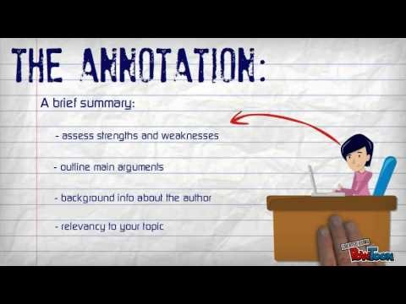
Annotated Bibliography Video (double click to access)

Slide 4
Sample Citation - Book
Holland, Suzanne. The Human Embryonic Stem Cell Debate: Science, Ethics, and Public Policy. Boston: MIT Press, 2001. Print.
MLA format
Double-spaced
Titles are italicized

Slide 5
Sample Citation: Web Articles
Editor, author, or compiler name (if available). “Article Name.” Name of Site. Date of last update. Medium of publication. Date of access.
Example:
Waite, Linda J. "Nonfamily Living and the Erosion of Traditional Family Orientations Among Young Adults." American Sociological Review. 02 Mar 2011. Web. 06 Feb 2018.
Remember, MLA Rules state that you insert all of the information in the Works Cited entry IF IT’S AVAILIBLE. If it’s not, do not include it. For example, if there is not a “last updated” date listed on the site, you do not have to include it in your entry. Plug in anything that’s available.

Slide 6
Credible Sources Video (double click to access)

Slide 7
Annotation Section
Our annotated bibliographies for Exhibitions will each include ONE paragraph which includes the following 3 elements:
1. Summary
2. Assessment
3. Reflection
Notes:
May be modified for special needs students

Slide 8
1: Summary
Summarize: Some annotations merely summarize the source. What are the main arguments? What is the point of this book or article? What topics are covered? If someone asked what this article/book is about, what would you say? The length of your annotations will determine how detailed your summary is.
Sentence starters:
The main idea of this article is…….
The topics covered in this article are…….
The author’s point of view in this article is……

Slide 9
2: Assessment
Assess: After summarizing a source, it may be helpful to evaluate it. Is it a useful source? How does it compare with other sources in your bibliography? Is it credible? Is the information reliable? Is this source biased or objective? What is the goal of this source?
Sentence Starters:
The author of this piece is/is not credible because……
The author knows a lot about this topic because….
From this piece, the author wants you to………….

Slide 10
3: Reflection
Reflect: Once you've summarized and assessed a source, you need to ask how it fits into your research. Was this source helpful to you? How does it help you shape your argument? How can you use this source in your research project? Has it changed how you think about your topic?
Sentence Starters:
This article supports my ideas because…..
This article was helpful to me because….
This article added to my knowledge about this topic because….

