Slide 1
Exponent Laws

Slide 2
Chapter 1
It was a rainy Friday in Toronto Canada when Timothy and Sidney had finished doing their daily talk show simply titled Tim & Sid. Timothy and Sidney had been friends for a long time and usually grabbed a cup of coffee after their show. Timothy decided to tell Sidney that they should do something fun over the weekend. Sidney suggested an escape room. They both thought that would be a good idea

Slide 3
Chapter 2
Saturday came and it was raining again, Timothy and Sidney took the drive in Sid's 1998 sedan, from Toronto to Mississauga, they entered this escape room place and paid 49 dollars for the both of them.

Slide 4
Chapter 3
After waiting 25 minuets Timothy and Sidney were asked to go into their escape rooms. They were given a short amount of time to finish each room. The first test was a question to answer. Timothy and Sidney were asked to state which is the base and which is the exponent in the equation 4^3. Timothy thought the base was 4 and the exponent was 3, but Sidney thought it wasn't. After some debating, they agreed to answer that 4 was the base and the exponent was 3. It turns out they were wright and can go to the next room.

Slide 5
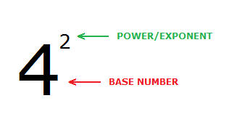
Chapter 4
When Timothy and Sidney finished their first room, they were told to go into an almost identical room. In this room they found out that they had to solve the equation and find out which answer would be negative. Timothy and Sidney were given two exponents both with a negative sign but one with a bracket. Timothy said they should do sign analysis; Sidney didn't know what sign analysis was. Timothy said if the exponent is even then the answer will be positive. But by this time Sidney had forgot what an exponent was. Timothy did the work himself and answered -4squared = negative 16. And Timothy also answered (-4)squared=16. Both answers looked similar but when Timothy entered them in, they were approved to go to the next room.

Slide 6
Chapter 5
Timothy and Sidney were noticing that the rooms were getting harder, so they decided to quiz each other on some basic math problems like 2+3, 9+9, 4+4, 10x10, 2x3 and so on. Not surprisingly Timohy got more questions right. The point of the next room was to solve another exponent equation. They had to evaluate two expressions. Both equations weren’t that tough but for the first time Timothy didn't know what to do. Sidney suggested they should add the two exponents, but Timothy said that would be two easy. Sidney said they should divide them, but Timothy said that would be too hard. After some thinking they agreed to multiply the exponents on both questions. For the first question they said it would be Y to the power of 42, and for the second question which was (8^2)^9, to be 8^18. Both Timothy and Sidney found this easy as you just must multiply the two exponents together.

Slide 7
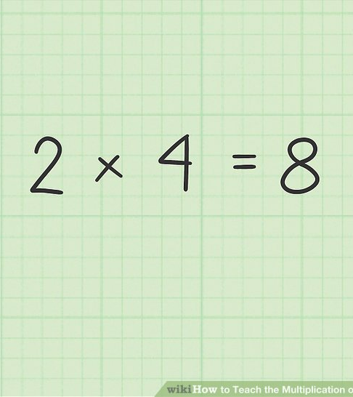
Chapter 6
After Timothy and Sidney finished their latest room, they thought they would be done, but it turns out there was just one more room left. If they were to get this room correct, they would be able to successfully escape their escape room. In this room there was two questions one was to solve this math equation (2a^3 x)(4a^2 x^7) and the other was to find the value of an exponent that is the power of zero. The first equation took some thinking, but Timothy used what he had learned in the previous rooms to simplify. He tried adding all numbers but that didn't make sense, Timothy tried just about every math equation until he decided to multiply the two whole numbers 2x4 which gave him 8. Then he tried to multiply the exponents but before he submitted it, he decided to try and add the exponents a^3+a^2=a^5 This gave him –8a^5. But there was still more to be done. Timothy knew that there was no exponents on one of the x. So, Timothy wanted to write the X as X^7. But Sidney piped in and said the the exponent on the first X was 1 so the answer to the X equation within the whole equation was X^8. Timothy agreed and it gave them their final answer –8 a^5 x^8. Timothy and Sidney submitted their answer, and they were correct.

Slide 8
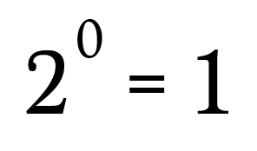
Chapter 7
Now that Timothy and Sidney had finished their equation, they still had to find the value of 2^0. Timothy and Sidney thought this would be easy as the answer would just be zero. But that was too easy. Timothy and Sidney had no choice but to guess. They knew that it could be above 2 or below 2. Timothy had no idea, so they decided to submit 10 as the answer. As they anxiously awaited their results, they almost knew they were wrong. It was later found out that they were wrong, and the correct answer was 1. Timothy and Sidney said they would have never guessed that and that they had officially failed to escape the escape room.

Slide 9
Chapter 8
Even though the escape room ended in disappointment Timothy and Sidney still learned a lot of Math content as they learned five new exponent laws:
What a base is
What an exponent is
How to find a negative exponent
Power to a power
Solving an exponential equation
Exponent of zero.
Timothy and Sidney both enjoyed the escape room, but they don't think they would do it again.

